Slide 1
Java DataBase Connectivity

Slide 2
JDBC
Java Database Connectivity (JDBC) is an application programming interface (API) for the programming language Java, which defines how a client may access a database.
It is part of the Java Standard Edition platform, from Oracle Corporation.
JDBC connect and execute query with the database. JDBC API uses jdbc drivers to connect with the database.

Slide 3
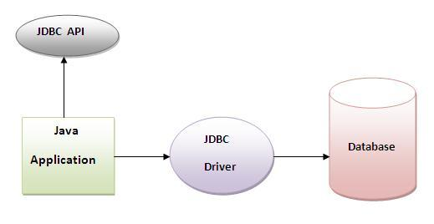
JDBC

Slide 4
Why to use JDBC?
Before JDBC, ODBC API was the database API to connect and execute query with the database.
But, ODBC API uses ODBC driver which is written in C language (i.e. platform dependent and unsecured). That is why Java has defined its own API (JDBC API) that uses JDBC drivers (written in Java language).

Slide 5
JDBC DRIVERS
There are 4 types of JDBC drivers:
JDBC-ODBC bridge driver
Native-API driver (partially java driver)
Network Protocol driver (fully java driver)
Thin driver (fully java driver)

Slide 6
JDBC-ODBC bridge driver
The JDBC-ODBC bridge driver uses ODBC driver to connect to the database.
The JDBC-ODBC bridge driver converts JDBC method calls into the ODBC function calls.
This is now discouraged because of thin driver.

Slide 7
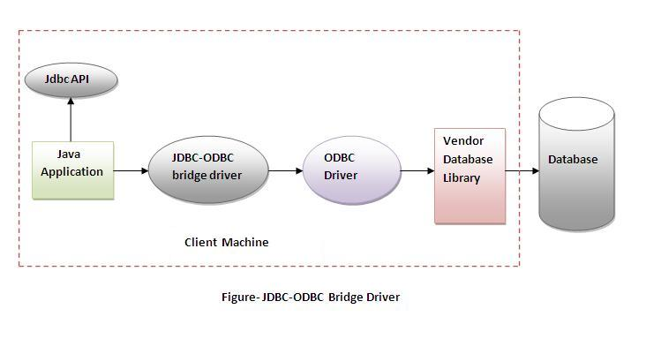
JDBC-ODBC bridge driver

Slide 8
JDBC-ODBC bridge driver
Advantages:
easy to use.
can be easily connected to any database.
Disadvantages:
Performance degraded because JDBC method call is converted into the ODBC function calls.
The ODBC driver needs to be installed on the client machine.

Slide 9
Native-API driver (partially java driver)
The Native API driver uses the client-side libraries of the database. The driver converts JDBC method calls into native calls of the database API. It is not written entirely in java.

Slide 10
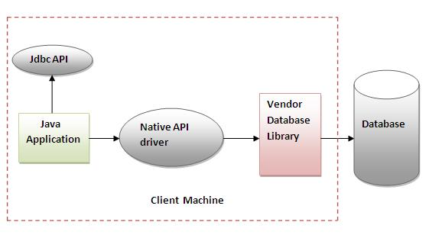
Native-API driver (partially java driver)

Slide 11
Native-API driver (partially java driver)
Advantage:
performance upgraded than JDBC-ODBC bridge driver.
Disadvantage:
The Native driver needs to be installed on the each client machine.
The Vendor client library needs to be installed on client machine.

Slide 12
Network Protocol driver (fully java driver)
The Network Protocol driver uses middleware (application server) that converts JDBC calls directly or indirectly into the vendor-specific database protocol. It is fully written in java.

Slide 13
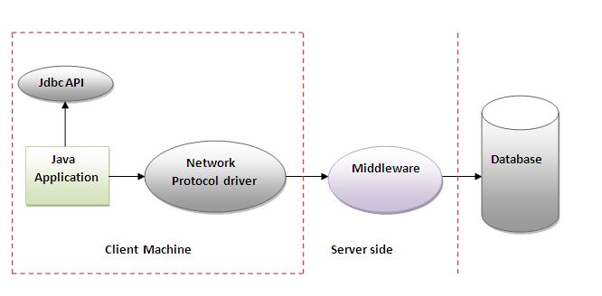
Network Protocol driver (fully java driver)

Slide 14
Network Protocol driver (fully java driver)
Advantage:
No client side library is required because of application server that can perform many tasks like auditing, load balancing, logging etc.
Disadvantages:
Network support is required on client machine.
Requires database-specific coding to be done in the middle tier.
Maintenance of Network Protocol driver becomes costly because it requires database-specific coding to be done in the middle tier.

Slide 15
Thin driver (fully java driver)
The thin driver converts JDBC calls directly into the vendor-specific database protocol. That is why it is known as thin driver. It is fully written in Java language.

Slide 16
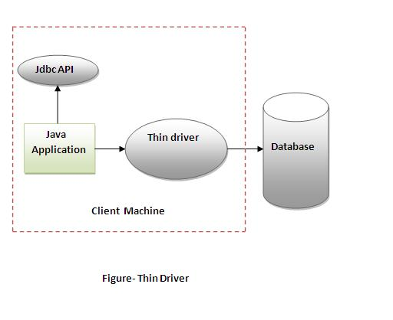
Thin driver (fully java driver)

Slide 17
Thin driver (fully java driver)
Advantage:
Better performance than all other drivers.
No software is required at client side or server side.
Disadvantage:
Drivers depends on the Database.

Slide 18
Steps to connect to the database in java
There are 5 steps to connect any java application with the database in java using JDBC. They are as follows:
Register the driver class
Creating connection
Creating statement
Executing queries
Closing connection

Slide 19
Register the driver class
The forName() method of Class class is used to register the driver class. This method is used to dynamically load the driver class.
Syntax of forName() method:
public static void forName(String className) throws Clas sNotFoundException
Example to register the OracleDriver class:
Class.forName("oracle.jdbc.driver.OracleDriver");

Slide 20
Creating connection
The getConnection() method of DriverManager class is used to establish connection with the database.
Syntax of getConnection() method:
public static Connection getConnection(String url)throws SQLException
public static Connection getConnection(String url,String name,String password) throws SQLException

Slide 21
Creating connection
Example:
Connection con=DriverManager.getConnection( "jdbc:oracle:thin:@localhost:1521:xe","system","password");

Slide 22
Creating statement
The createStatement() method of Connection interface is used to create statement. The object of statement is responsible to execute queries with the database.
Syntax of createStatement() method
public Statement createStatement()throws SQLException
Example to create the statement object
Statement stmt=con.createStatement();

Slide 23
Execute the query
The executeQuery() method of Statement interface is used to execute queries to the database. This method returns the object of ResultSet that can be used to get all the records of a table.
Syntax of executeQuery() method:
public ResultSet executeQuery(String sql)throws SQLException
Example to execute query:
ResultSet rs=stmt.executeQuery("select * from emp");
while(rs.next()){
System.out.println(rs.getInt(1)+" "+rs.getString(2));
}

Slide 24
Close the connection object
By closing connection object statement and ResultSet will be closed automatically. The close() method of Connection interface is used to close the connection.
Syntax of close() method:
public void close()throws SQLException
Example to close connection:
con.close();

Slide 25
Example to Connect Java Application with Oracle database
import java.sql.*;
class OracleCon{
public static void main(String args[]){
try{
//step1 load the driver class
Class.forName("oracle.jdbc.driver.OracleDriver");
//step2 create the connection object
Connection con=DriverManager.getConnection(
"jdbc:oracle:thin:@localhost:1521:xe","system","oracle");

Slide 26
//step3 create the statement object
Statement stmt=con.createStatement();
//step4 execute query
ResultSet rs=stmt.executeQuery("select * from emp");
while(rs.next())
System.out.println(rs.getInt(1)+" "+rs.getString(2)+" "+rs.getString(3));
//step5 close the connection object
con.close();
}catch(Exception e){ System.out.println(e);
}
}
}

Slide 27
Connection interface
A Connection is the session between java application and database. The Connection interface is a factory of Statement, PreparedStatement, and DatabaseMetaData i.e. object of Connection can be used to get the object of Statement and DatabaseMetaData.
The Connection interface provide many methods for transaction management like commit(), rollback() etc.

Slide 28
Commonly used methods
1) public Statement createStatement(): creates a statement object that can be used to execute SQL queries.
2) public Statement createStatement(int resultSetType,int resultSetConcurrency): Creates a Statement object that will generate ResultSet objects with the given type and concurrency.
3) public void setAutoCommit(boolean status): is used to set the commit status.By default it is true.
4) public void commit(): saves the changes made since the previous commit/rollback permanent.
5) public void rollback(): Drops all changes made since the previous commit/rollback.
6) public void close(): closes the connection and Releases a JDBC resources immediately.

Slide 29
Statement interface
The Statement interface provides methods to execute queries with the database. The statement interface is a factory of ResultSet i.e. it provides factory method to get the object of ResultSet.

Slide 30
Commonly used methods of Statement interface
public ResultSet executeQuery(String sql): is used to execute SELECT query. It returns the object of ResultSet.
public int executeUpdate(String sql): is used to execute specified query, it may be create, drop, insert, update, delete etc.
public boolean execute(String sql): is used to execute queries that may return multiple results.
public int[] executeBatch(): is used to execute batch of commands.

Slide 31
Example of Statement interface
import java.sql.*;
class FetchRecord{
public static void main(String args[])throws Exception{
Class.forName("oracle.jdbc.driver.OracleDriver");
Connection con=DriverManager.getConnection("jdbc:oracle:thin:@localhost:1521:xe","system","oracle");
Statement stmt=con.createStatement();
//stmt.executeUpdate("insert into emp765 values(33,'Irfan',50000)");
//int result=stmt.executeUpdate("update emp765 set name='Vimal',salary=10000 where id=33");
int result=stmt.executeUpdate("delete from emp765 where id=33");
System.out.println(result+" records affected");
con.close();
}}

Slide 32
ResultSet interface
The object of ResultSet maintains a cursor pointing to a row of a table. Initially, cursor points to before the first row.
But we can make this object to move forward and backward direction by passing either TYPE_SCROLL_INSENSITIVE or TYPE_SCROLL_SENSITIVE in createStatement(int,int) method as well as we can make this object as updatable by:
Statement stmt = con.createStatement(ResultSet.TYPE_SCROLL_INSENSITIVE, ResultSet.CONCUR_UPDATABLE);

Slide 33
ResultSetMetaData Interface
The metadata means data about data i.e. we can get further information from the data.
If you have to get metadata of a table like total number of column, column name, column type etc. , ResultSetMetaData interface is useful because it provides methods to get metadata from the ResultSet object.

Slide 34
Commonly used methods of ResultSetMetaData interface
Method | Description
public int getColumnCount()throws SQLException | it returns the total number of columns in the ResultSet object.
public String getColumnName(int index)throws SQLException | it returns the column name of the specified column index.
public String getColumnTypeName(int index)throws SQLException | it returns the column type name for the specified index.
public String getTableName(int index)throws SQLException | it returns the table name for the specified column index.

Slide 35
How to get the object of ResultSetMetaData
public ResultSetMetaData getMetaData()throws SQLException

Slide 36
Java Bean
JavaBeans makes it easy to reuse software components.
Developers can use software components written by others without having to understand their inner workings.

Slide 37
Java Bean
For example:
Think of a worker assembling a car. Instead of building a radio from scratch, for example, she simply obtains a radio and hooks it up with the rest of the car.

Slide 38
Java Bean
A Java Bean is a java class that should follow following conventions:
It should have a no-args constructor.
It should be Serializable.
It should provide methods to set and get the values of the properties, known as getter and setter methods.

Slide 39
Why use Java Bean?
Java Bean is a reusable software component.
A bean encapsulates many objects into one object, so we can access this object from multiple places. Moreover, it provides the easy maintenance.

Slide 40
Example
public class Employee implements java.io.Serializable
{
private int id;
private String name;
public Employee(){}
public void setId(int id){
this.id=id;
}
public int getId(){
return id;
}
public void setName(String name){this.name=name;}
public String getName()
{return name;
}
}

Slide 41
Accessing Java Bean Class
public class Test
{
public static void main(String args[])
{
Employee e=new Employee();
e.setName(“Ram");
System.out.println(e.getName());
}
}

Slide 42
Advantages
Beans are persist able and can be stored and retrieved back from permanent storage.
A bean can be customized and manipulated by some auxiliary software.
We can control what properties, methods, and events are to be exposed to the application that wants to use it.
A bean can not only be registered to receive events send by another object, but also generate events.

Slide 43
Disadvantages
The benefits of immutable objects are absent in beans because they are by default mutable.
Because every Java bean must have a no-argument constructor (null constructor), this may lead to an object being instantiated in an invalid state.
Bean classes contain much boilerplate code because, as per specification, most or all private properties must be exposed through public getters and setters. This often leads to writing many unnecessary codes.

Slide 44
JAR Files
A JAR (Java ARchive) is a package file format typically used to aggregate many Java class files and associated metadata and resources (text, images, etc.) into one file for distribution.
JAR files are archive files with which include a Java-specific manifest file.

Slide 45
JAR Files
JAR files are packaged with the ZIP file format, so you can use them for tasks such as lossless data compression, archiving, decompression, and archive unpacking.
These tasks are among the most common uses of JAR files, and you can realize many JAR file benefits using only these basic features.

Slide 46
Creating JAR Files
The basic format of the command for creating a JAR file is:
jar cf jar-file input-file(s)
The options and arguments used in this command are:
The c option indicates that you want to create a JAR file.
The f option indicates that you want the output to go to a file rather than to stdout.

Slide 47
Creating JAR Files
jar-file is the name that you want the resulting JAR file to have. You can use any filename for a JAR file. By convention, JAR filenames are given a .jar extension, though this is not required.
The input-file(s) argument is a space-separated list of one or more files that you want to include in your JAR file. The input-file(s) argument can contain the wildcard * symbol.

Slide 48
Creating JAR Files
If any of the "input-files" are directories, the contents of those directories are added to the JAR archive recursively.
The c and f options can appear in either order, but there must not be any space between them.
This command will generate a compressed JAR file and place it in the current directory. The command will also generate a default manifest file for the JAR archive.

Slide 49
SERVLET
Servlet technology is used to create web application (resides at server side and generates dynamic web page).
Servlet technology is robust and scalable because of java language.
Before Servlet, CGI (Common Gateway Interface) scripting language was popular as a server-side programming language. But there was many disadvantages of this technology.
There are many interfaces and classes in the servlet API such as Servlet, HttpServlet, ServletRequest, ServletResponse, etc.

Slide 50
SERVLET
Servlet is a technology i.e. used to create web application.
Servlet is an API that provides many interfaces and classes including documentations.
Servlet is a class that extend the capabilities of the servers and respond to the incoming request. It can respond to any type of requests.
Servlet is a web component that is deployed on the server to create dynamic web page.

Slide 51
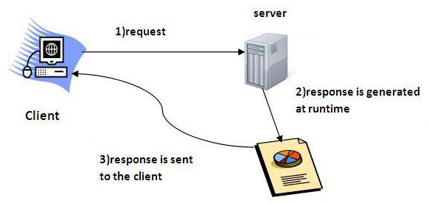
SERVLET

Slide 52
CGI(Common Gateway Interface)
CGI technology enables the web server to call an external program and pass HTTP request information to the external program to process the request. For each request, it starts a new process.

Slide 53
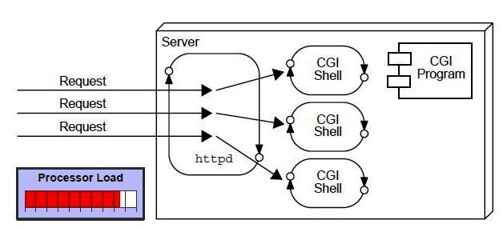

Slide 54
Disadvantages of CGI
There are many problems in CGI technology:
If number of clients increases, it takes more time for sending response.
For each request, it starts a process and Web server is limited to start processes.
It uses platform dependent language e.g. C, C++, perl.

Slide 55
Advantage of Servlet
There are many advantages of servlet over CGI.
The web container creates threads for handling the multiple requests to the servlet.
Threads have a lot of benefits over the Processes such as they share a common memory area, lightweight, cost of communication between the threads are low.

Slide 56
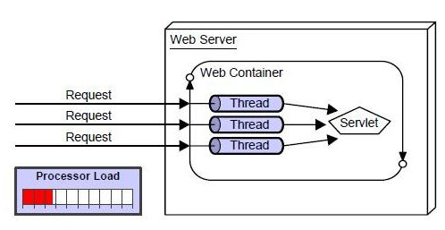

Slide 57
Advantage of Servlet
better performance: because it creates a thread for each request not process.
Portability: because it uses java language.
Robust: Servlets are managed by JVM so we don't need to worry about memory leak, garbage collection etc.
Secure: because it uses java language..

Slide 58
Servlet Life Cycle
The web container maintains the life cycle of a servlet instance. Let's see the life cycle of the servlet:
Servlet class is loaded.
Servlet instance is created.
init method is invoked.
service method is invoked.
destroy method is invoked.

Slide 59
Servlet class is loaded
The classloader is responsible to load the servlet class. The servlet class is loaded when the first request for the servlet is received by the web container.

Slide 60
Servlet instance is created
The web container creates the instance of a servlet after loading the servlet class. The servlet instance is created only once in the servlet life cycle.

Slide 61
init method is invoked
The web container calls the init method only once after creating the servlet instance. The init method is used to initialize the servlet.
It is the life cycle method of the javax.servlet.Servlet interface.
Syntax:
public void init(ServletConfig config) throws ServletException

Slide 62
service method is invoked
The web container calls the service method each time when request for the servlet is received. If servlet is not initialized, it follows the first three steps as described above then calls the service method. If servlet is initialized, it calls the service method. Servlet is initialized only once.

Slide 63
service method is invoked
Syntax:
public void service(ServletRequest request, ServletResponse response) throws ServletException, IOException

Slide 64
destroy method is invoked
The web container calls the destroy method before removing the servlet instance from the service. It gives the servlet an opportunity to clean up any resource for example memory, thread etc.
Syntax:
public void destroy()

Slide 65
Session Tracking in Servlets
Session simply means a particular interval of time.
Session Tracking is a way to maintain state (data) of an user. It is also known as session management in servlet.
Each time user requests to the server, server treats the request as the new request. So we need to maintain the state of an user to recognize to particular user.
Each request is considered as the new request.

Slide 66
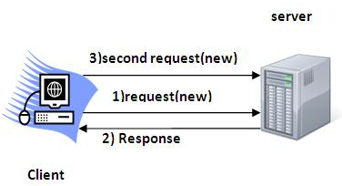
Session Tracking in Servlets

Slide 67
Why use Session Tracking?
To recognize the user It is used to recognize the particular user.
There are four techniques used in Session tracking:
Cookies
Hidden Form Field
URL Rewriting
HttpSession

Slide 68
Cookies in Servlet
A cookie is a small piece of information that is persisted between the multiple client requests.
A cookie has a name, a single value, and optional attributes such as a comment, path and domain qualifiers, a maximum age, and a version number.

Slide 69
Cookies in Servlet
By default, each request is considered as a new request. In cookies technique, we add cookie with response from the servlet.
So cookie is stored in the cache of the browser.
After that if request is sent by the user, cookie is added with request by default. Thus, we recognize the user as the old user.

Slide 70
Types of Cookie
There are 2 types of cookies in servlets.
Non-persistent cookie
Persistent cookie
Non-persistent cookie
It is valid for single session only. It is removed each time when user closes the browser.
Persistent cookie
It is valid for multiple session . It is not removed each time when user closes the browser. It is removed only if user logout or sign out.

Slide 71
Cookies in Servlet
Advantage of Cookies
Simplest technique of maintaining the state.
Cookies are maintained at client side.
Disadvantage of Cookies
It will not work if cookie is disabled from the browser.
Only textual information can be set in Cookie object.

Slide 72
Hidden Form Field
In Hidden Form Field a hidden (invisible) text field is used for maintaining the state of an user.
In such case, the information is stored in the hidden field and get it from another servlet.
This approach is better if we have to submit form in all the pages and we don't want to depend on the browser.
Example:
<input type="hidden" name="uname" value="Vimal Jaiswal">

Slide 73
Hidden Form Field
Advantage of Hidden Form Field
It will always work whether cookie is disabled or not.
Disadvantage of Hidden Form Field:
It is maintained at server side.
Extra form submission is required on each pages.
Only textual information can be used.

Slide 74
URL Rewriting
In URL rewriting, we append a token or identifier to the URL of the next Servlet or the next resource.
We can send parameter name/value pairs using the following format:
url?name1=value1&name2=value2&??
A name and a value is separated using an equal = sign, a parameter name/value pair is separated from another parameter using the ampersand(&).
When the user clicks the hyperlink, the parameter name/value pairs will be passed to the server. From a Servlet, we can use getParameter() method to obtain a parameter value.

Slide 75
URL Rewriting
Advantage of URL Rewriting
It will always work whether cookie is disabled or not (browser independent).
Extra form submission is not required on each pages.
Disadvantage of URL Rewriting
It will work only with links.
It can send Only textual information.

Slide 76
HttpSession interface
In such case, container creates a session id for each user.
The container uses this id to identify the particular user. An object of HttpSession can be used to perform two tasks:
bind objects
view and manipulate information about a session, such as the session identifier, creation time, and last accessed time.

Slide 77
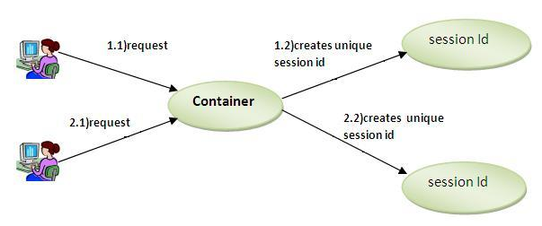
HttpSession interface

Slide 78
Creating Compiling And Running Servlet
Create a directory structure under Tomcat for your application.
Write the servlet source code. You need to import the javax.servlet package and the javax.servlet.http package in your source file.
Compile your source code.
Create a deployment descriptor.
Run Tomcat.
Call your servlet from a web browser.

Slide 79
Creating Compiling And Running Servlet
For further description:
Go To:
https://www.javatpoint.com/steps-to-create-a-servlet-using-tomcat-server

Slide 80
Reading servlet and initialization parameter
The browser uses two methods to pass information to web server.
These methods are GET Method and POST Method.
GET method
POST method

Slide 81
GET method
The GET method is the default method to pass information from browser to web server and it produces a long string that appears in your browser's Location:box.
Never use the GET method if you have password or other sensitive information to pass to the server. The GET method has size limitation: only 1024 characters can be in a request string.
This information is passed using QUERY_STRING header and will be accessible through QUERY_STRING environment variable and Servlet handles this type of requests using doGet() method.

Slide 82
POST method
A generally more reliable method of passing information to a backend program is the POST method.
This packages the information in exactly the same way as GET methods, but instead of sending it as a text string after a ? in the URL it sends it as a separate message.
This message comes to the backend program in the form of the standard input which you can parse and use for your processing. Servlet handles this type of requests using doPost() method.

Slide 83
Reading Form Data using Servlet
Servlets handles form data parsing automatically using the following methods depending on the situation:
getParameter(): You call request.getParameter() method to get the value of a form parameter.
getParameterValues(): Call this method if the parameter appears more than once and returns multiple values, for example checkbox.
getParameterNames(): Call this method if you want a complete list of all parameters in the current request.

Slide 84
Difference between Get and Post
GET | POST
1) In case of Get request, only limited amount of data can be sent because data is sent in header. | In case of post request, large amount of data can be sent because data is sent in body.
2) Get request is not secured because data is exposed in URL bar. | Post request is secured because data is not exposed in URL bar.
3) Get request can be bookmarked. | Post request cannot be bookmarked.
4) Get request is idempotent . It means second request will be ignored until response of first request is delivered | Post request is non-idempotent.
5) Get request is more efficient and used more than Post. | Post request is less efficient and used less than get.

Slide 85
Package javax.servlet
The javax.servlet package contains a number of classes and interfaces that describe and define the contracts between a servlet class and the runtime environment provided for an instance of such a class by a conforming servlet container.
Interfaces include: Filter, FilterChain, FilterConfig, etc.
Class include: GenericServlet, ServletInputStream, etc.

